Slide 1


Charting Global Macro Trends
Lev Borodovsky

Slide 2
Let’s look at 3 largest economies
"Soft" vs. "Hard" economic data in the US: Which is right?
The ongoing recovery in the Eurozone: What are the risks? What are the challenges for the ECB?
Beijing's balancing act on China's economy: How to maintain steady growth while battling bubbles.

Slide 3
The United States

Slide 4
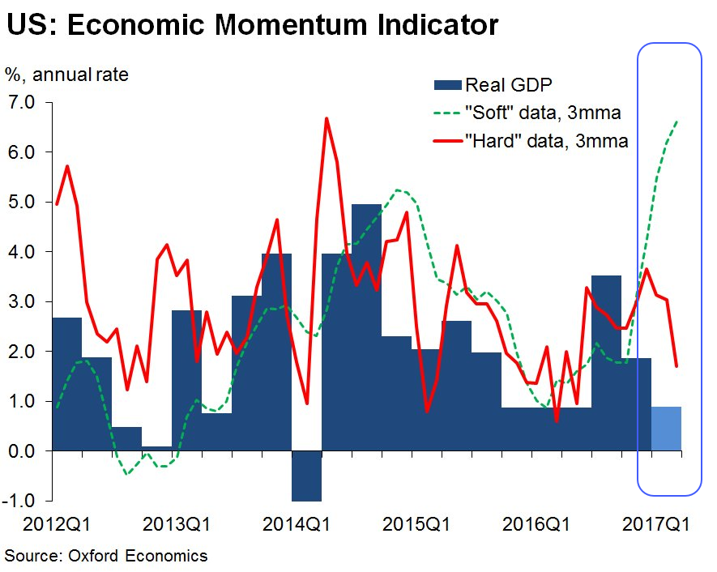
The disconnect between US “soft” (survey-based) and “hard” (official) data has been surprising

Slide 5
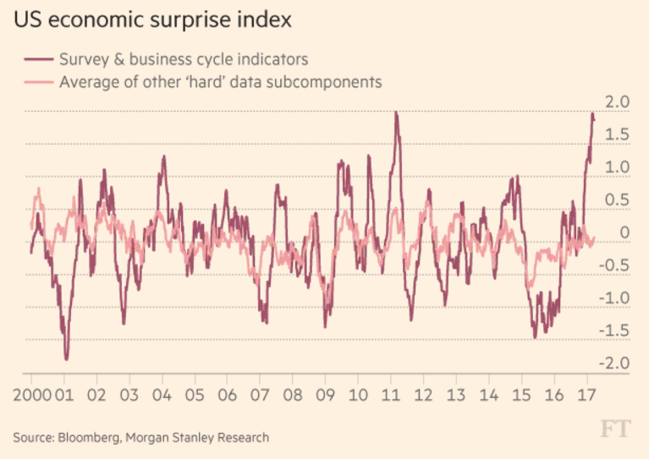
Economic surprise indices also point to this divergence

Slide 6
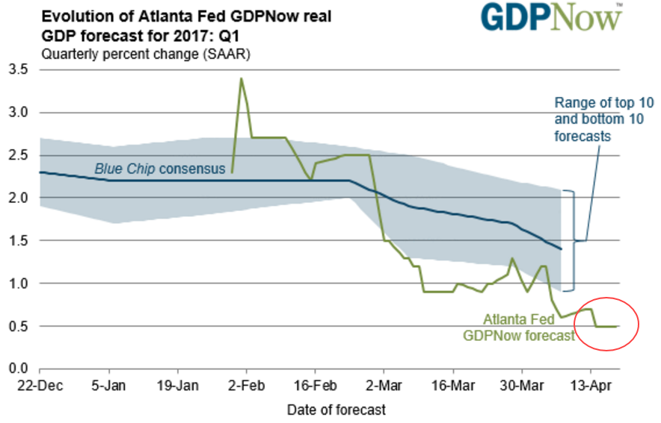
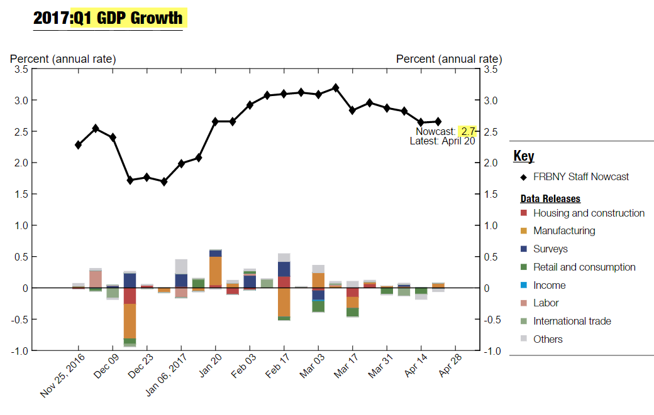
The disconnect shows up in the Atlanta Fed vs. NY Fed GDP tracking models
Q1 GDP growth forecast:

Slide 7
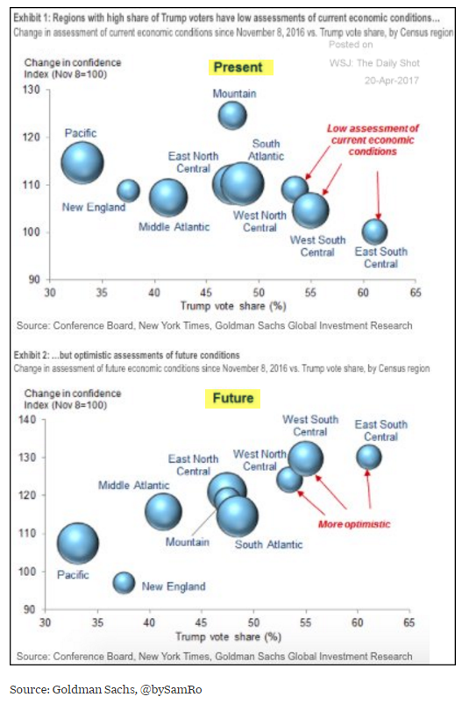
Some call it “political exuberance”

Slide 8
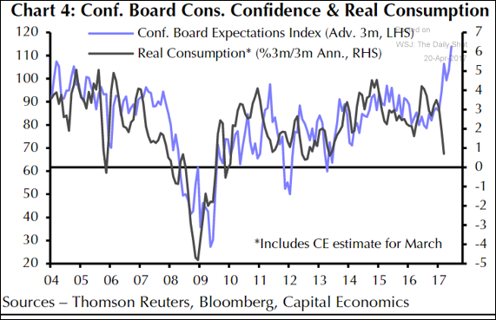
Consumer confidence versus consumer spending. Economists think spending will pick up.

Slide 9
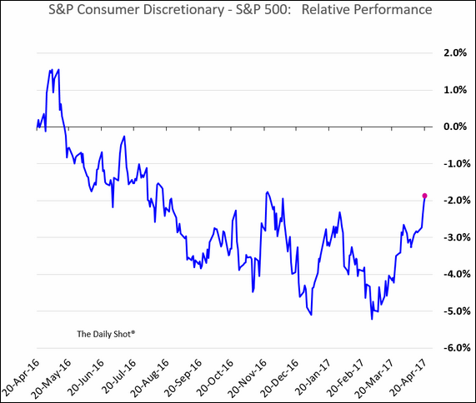
The markets are starting to believe some soft data

Slide 10
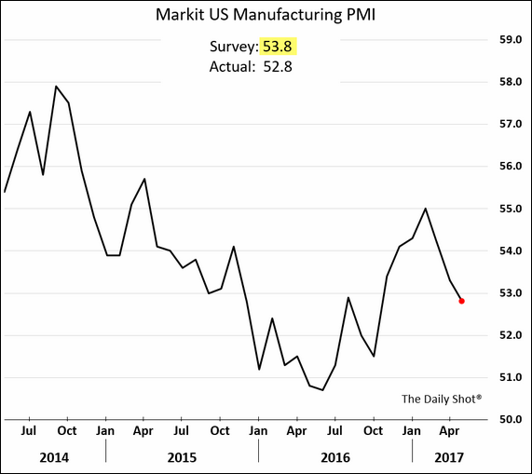
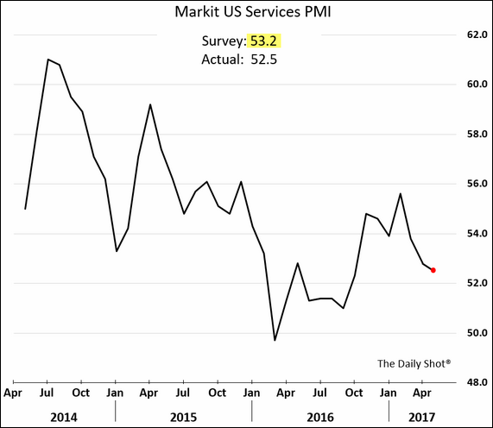
But now even some soft data is disappointing

Slide 11
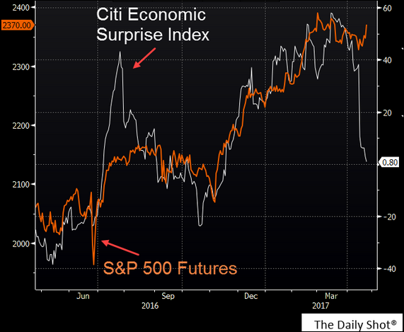
* Economic surprise index back to November lows. * Equity market remains hopeful.

Slide 12
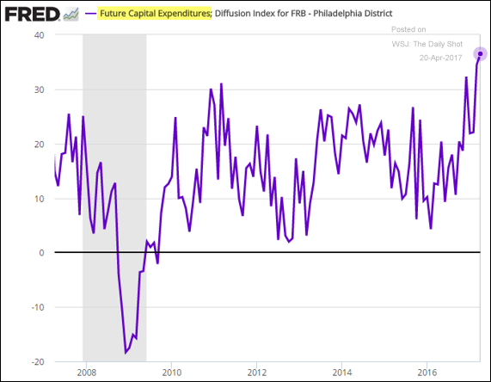
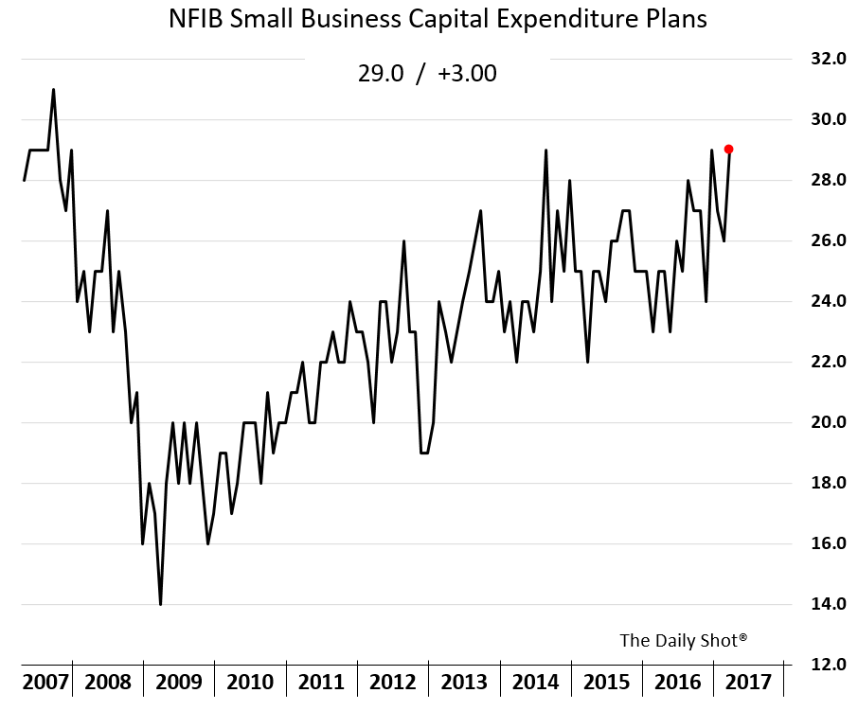
A boost in sentiment, however, may be spurring investment

Slide 13
Some questions:
Is the answer about the economy somewhere between “soft” and “hard” data?
Will consumer confidence translate into increased consumption?
Will business confidence boost CapEx?

Slide 14
The Eurozone

Slide 15
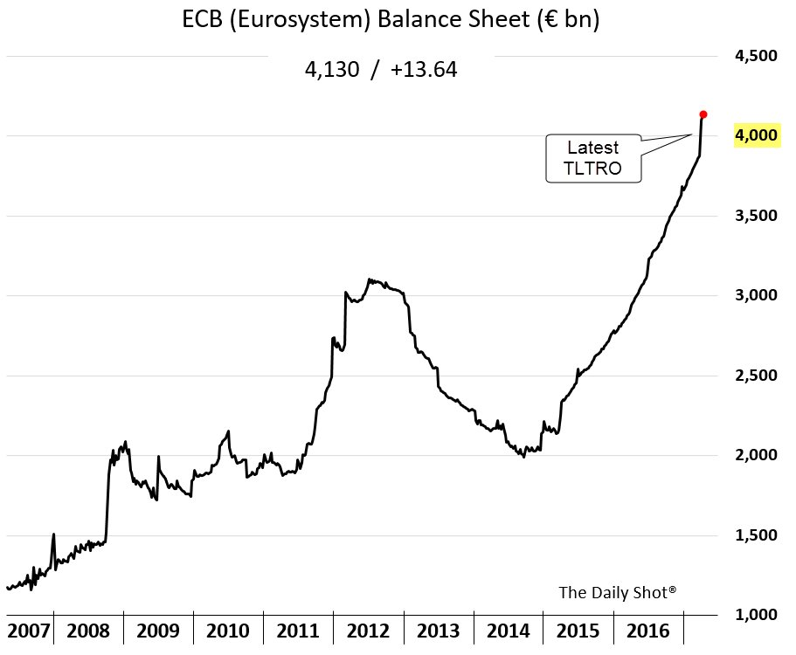
The ECB’s balance sheet blasts past ‎€4 trillion

Slide 16
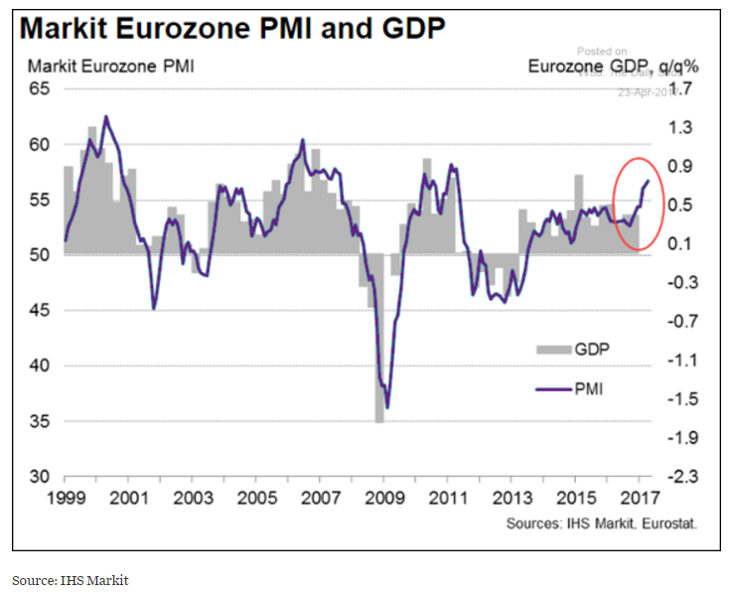
At the same time, economic activity is accelerating

Slide 17
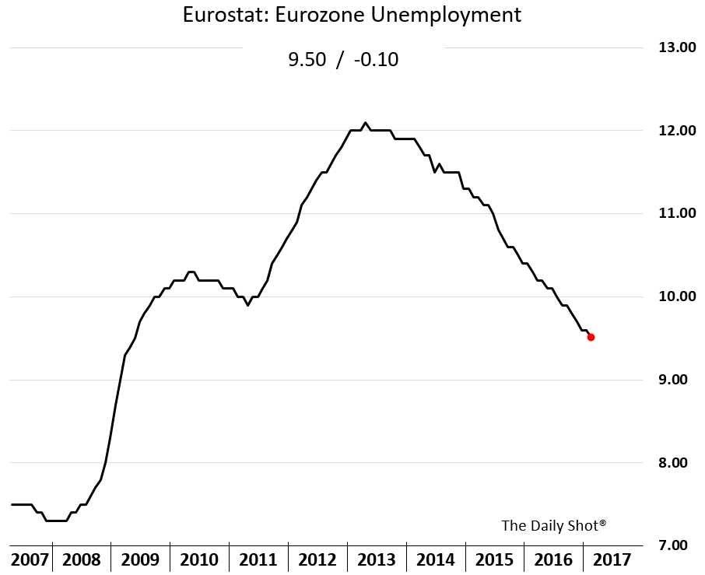
Labor markets are healing

Slide 18
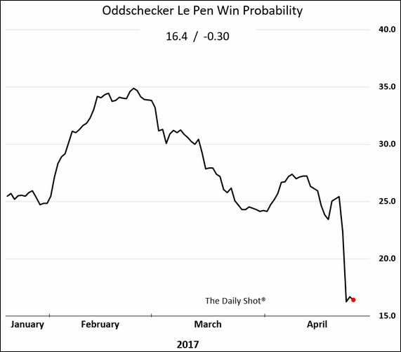
Political risks have eased

Slide 19
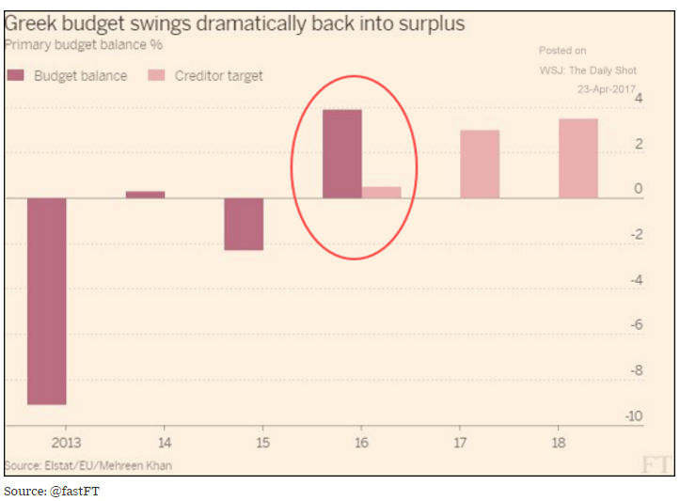
The Greece situation is improving

Slide 20
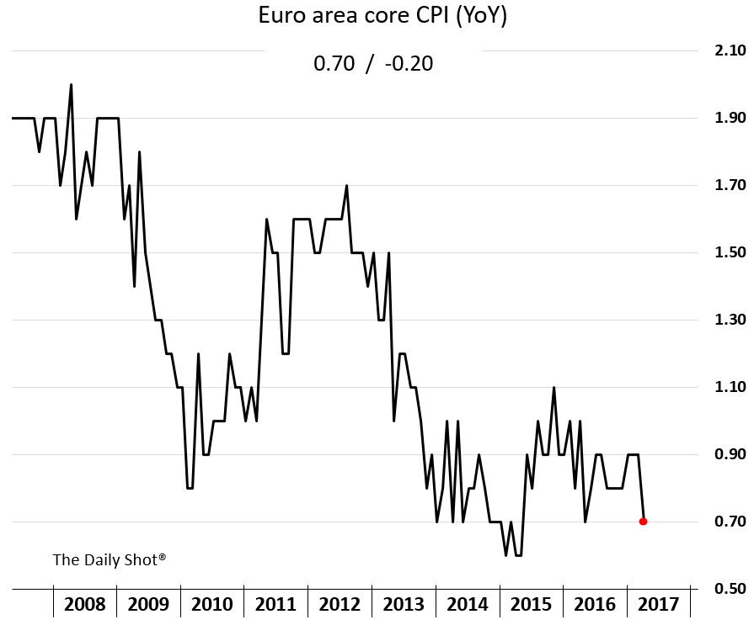
However, the ECB remains “shell shocked”
Concerns about the impact of US “protectionism.”
Fears of euro area political risks.
European banks’ capitalization uncertainty
Inflation still low and not rising.

Slide 21
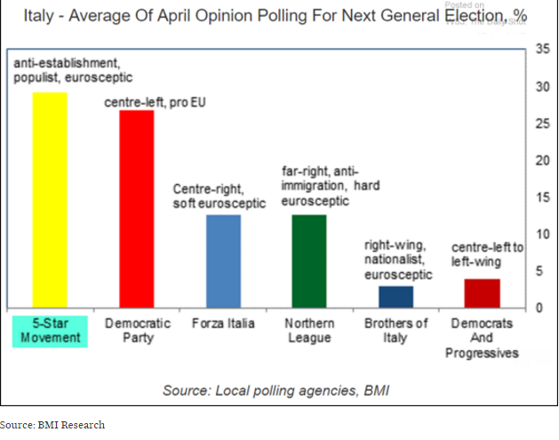
Italy is back on the radar

Slide 22
Some questions:
Given the economic improvements, are negative rates and the unprecedented QE justified?
Does the ECB have any “bullets” left if there is a geopolitical disruption?
What’s the exit strategy? Will the ECB hike rates before ending QE?

Slide 23
China

Slide 24
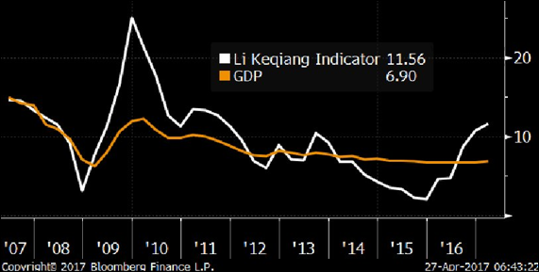
China’s economy is growing

Slide 25
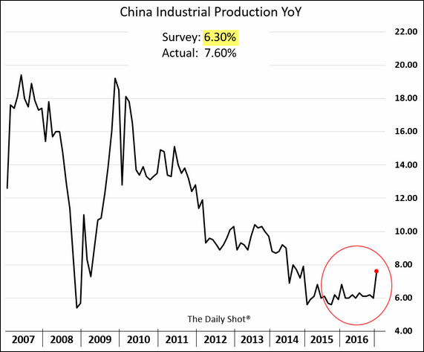
The “hard landing” concerns are no longer there

Slide 26
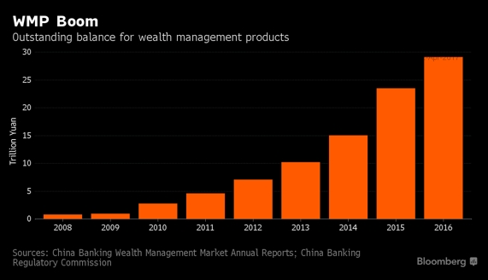
More importantly, Beijing has a problem: leveraged shadow banking system

Slide 27
The policy response has been a simultaneous fiscal stimulus AND a monetary tightening
Beijing is also focused on cooling the real estate market

Slide 28
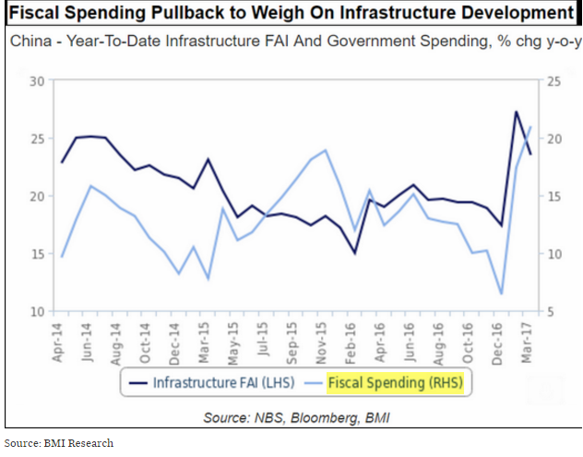
Growth remains linked to fiscal stimulus

Slide 29
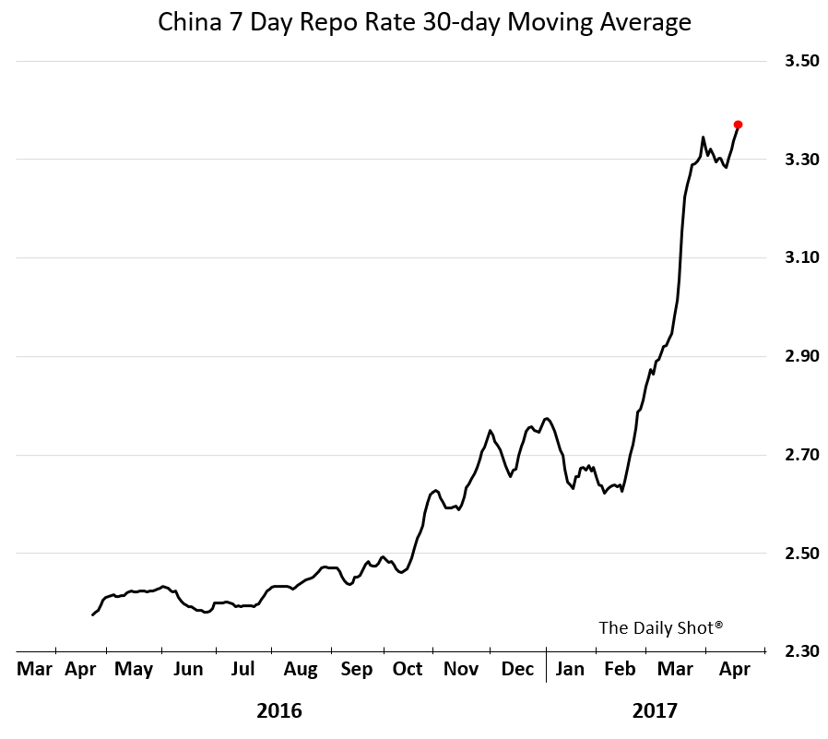
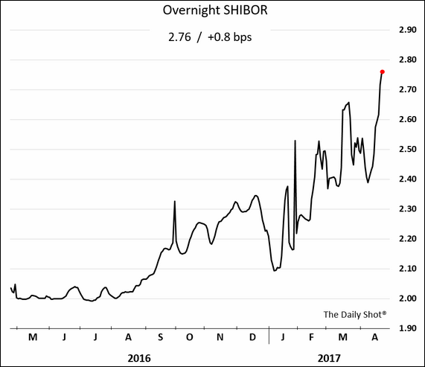
PBoC has been tightening liquidity to delever the system

Slide 30
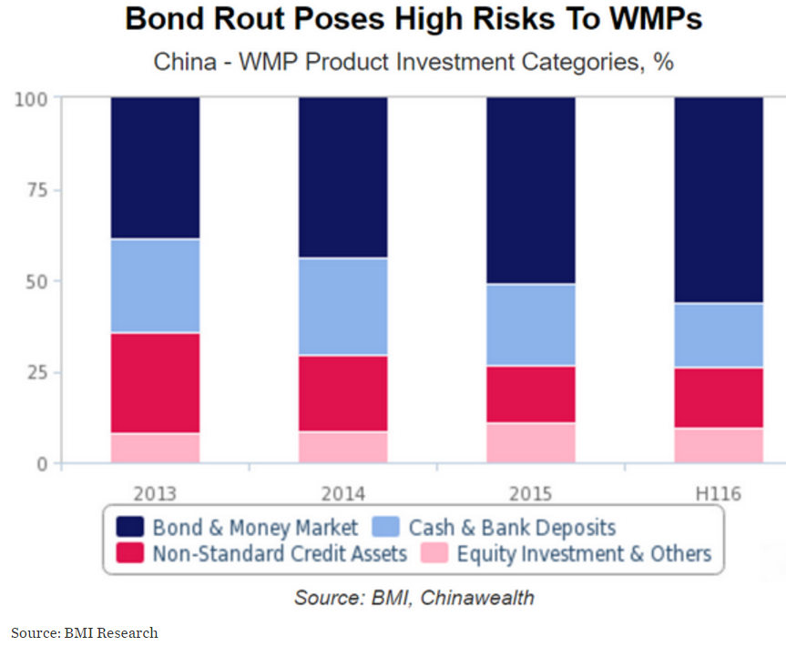
WMPs hold massive amounts of corporate debt

Slide 31
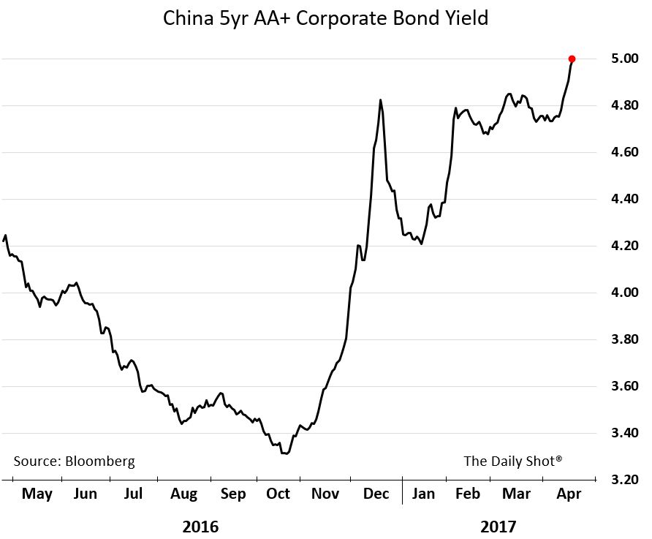
Bond yields respond to deleveraging

Slide 32
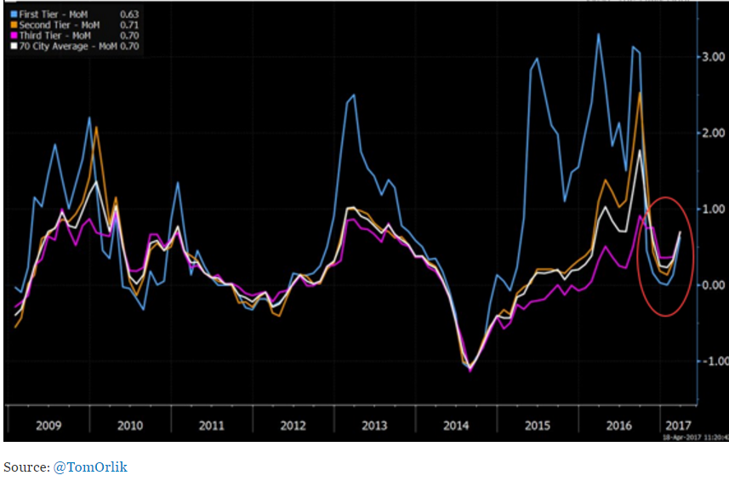
Tightening the property markets had only limited effects so far

Slide 33
Some questions:
Will the PBoC continue to tighten?
Will we see a liquidity event in (a run on) WMPs or other leveraged investment scheme?
Will Beijing end up bailing out WMPs?
How far is China willing to go to cool the property markets?

Slide 34
Food for Thought

Slide 35
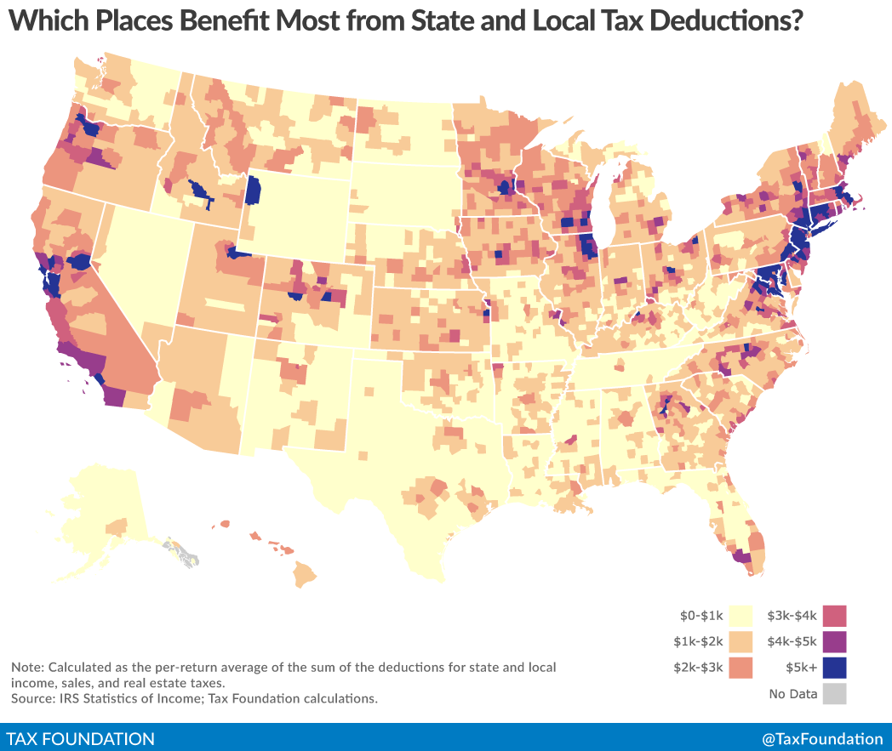
Who is going to get hurt the most from not being able to deduct state and local taxes? Many “blue” states, perhaps?

Slide 36
Thank you

Slide 37
The Daily Shot
For the Daily Shot Brief (free), sign up at: DailyShotLetter.com
For WSJ subscribers, sign up for the Daily Shot premium at: https://www.wsj.com/newsletters
The Daily Shot is available online at: DailyShotWSJ.com

